Slide 1
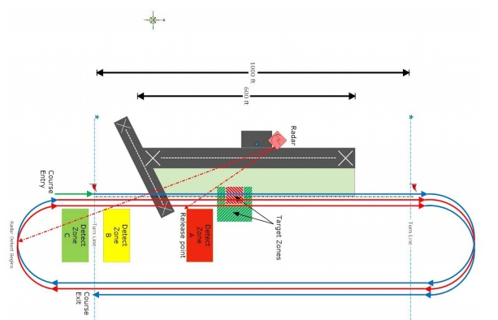
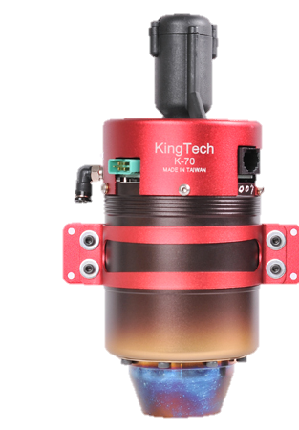
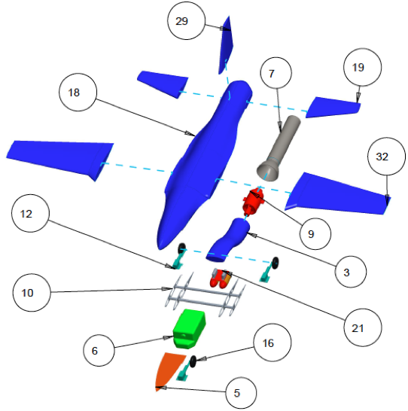
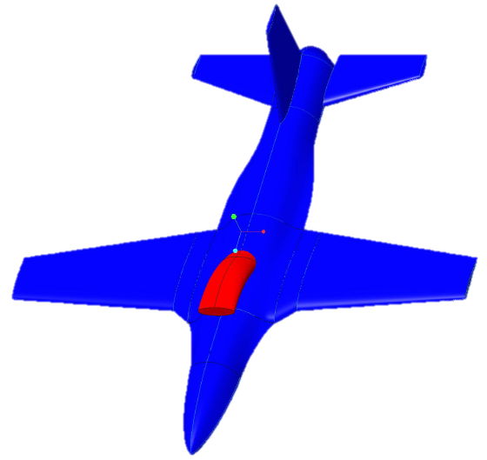
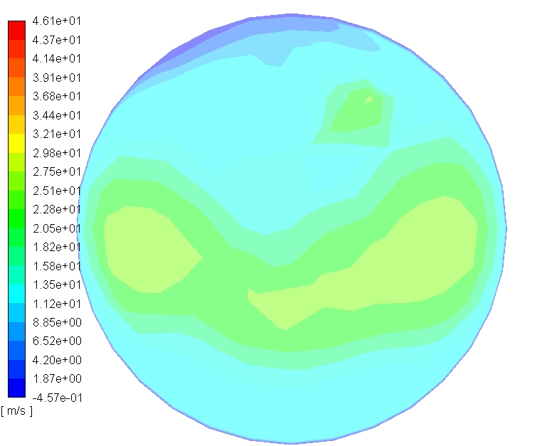
Speedfest VIII Alpha Class 2018
SPIRIT KATS- Aerodynamics & Propulsion
Department of Mechanical Engineering
Jonathan Hamilton, Corbin Mosser, William Sanders, Virginia Smith, Harrison Wight
Analysis
The wing has been analyzed using both computerized methods and parameters outlined in Daniel Raymer’s Aircraft Design: A Conceptual Approach. The Selig S8052 airfoil was chosen because it was designed for remote controlled aircraft pylon racing, a discipline similar to the speed runs visible in Figure 1. Figure 3 is a pseudocolor plot depicting the pressure gradient on the wing in an inviscid flow, which is meshed and analyzed with STAR-CCM+.
Figure 1: The Evade, Deploy, Recover Mission Envelope
Background
Figure 5: KingTech K70G2 Jet Turbine
Speedfest is a flight competition created by Oklahoma State University to provide an industry-practical alternative to the established AIAA Design Build Fly competition. Each year, Alpha (or collegiate) class teams are given a statement of work to respond to, which, for the past two years, have been performance oriented designs involving a turbine engine. The winning alpha class entries have been complex composite aircraft capable of speeds exceeding 150 mph. For Alpha Class 2018, teams are invited to demonstrate their ability to quickly design, develop, and test a fast attack/sensor deployment unmanned aerial vehicle (UAV). Teams will perform flight demonstrations of their prototypes, as well as host an exposition of their design to spectators and industry judges. Ideally, aircraft for the competition should be able to evade detection by radar and will serve in military and precise sensor deployment applications.
Prototyping Plan and Testing
The aircraft will be assembled by making a composite skin, mating it to an internal structure, and outfitting that structure with all internal components. The fuselage of the aircraft will be a clam-shell design that splits into an upper and lower half. The upper half of the fuselage will have a large, flush fit access panel in the nose to access the avionics equipment and refuel; and another mid-length to access the engine. The payload release system and landing gears will be drop-out subassemblies in the lower half of the aircraft. These components can be seen in Figure 6 below.
The engine, shown in Figure 5, will be tested extensively on a test stand before installation into the aircraft. This will allow for performance testing to ensure the engine will run smoothly at various aircraft orientations and perform as expected. Thermal studies can also be conducted to assure aircraft components surrounding the engine do not experience problems. Test flights will begin after assembly of the prototype is complete. This will allow for payload drops to be tested as well, and will validate the design .
Figure 3: Wing Pressure Gradient
XFLR5 has been used to provide preliminary stability analysis. Future analysis will utilize a viscous flow, and will involve analysis of the entire aircraft. This will enable accurate coefficient of lift and drag, critical angle of attack, and stability data to be obtained.
Approach
For a successful inlet design, the inlet must meet two somewhat interrelated requirements. The airflow to the face of the engine should be as uniform as possible for ideal performance and longevity. The airflow should also be devoid of areas of stagnation or backflow. In order to fulfil these requirements, the S-Duct was developed using the tool of Ansys Fluent for computation fluid dynamic analysis. The methodology used to study the effects of the overall form of the duct on the flow were observed through Two-Factor Three-Level testing, the factors being duct horizontal length and frontal capture area. Through this testing, it was discovered that a longer duct length with a small to medium sized capture area provided the best quality flow .
The requirements of this competition governed the design in all areas. The thrust for the aircraft was immediately decided to be provided by a miniature turbojet so that it could be housed inside the fuselage for radar avoidance. For design freedom, weight considerations, and material strength, the skin of the aircraft was decided to be of composite composition. A conventional fighter-like body style with a semi-lifting body fuselage was chosen for payload capacity, radar cross section, and speed/maneuverability considerations. The inlet to feed air to the engine was chosen to be an 'S' shaped duct for Foreign Object Damage (FOD) resistance and stealth considerations.
Figure 6 7:Aircraft Assembly Exploded View
Acknowledgements:
The UK Speedfest SPIRIT-KATS Team appreciates support from the Unmanned Aerial Vehicles (UAV) Lab, the Student Opportunity Fund, the Mechanical Engineering Department, and the NASA Kentucky Space Grant Consortium via NNX15AR69H.
Figure 2: Aerodynamic Design of Plane
Figure 4: Inlet Outgoing Velocity Profile
System for Payload Insertion with Radar Imperceptible Turbojet – Kentucky Air Tactical Solutions

